Slide 1





buildingblocks.png
Clients
FFDC
Core
Client GET
APIs
GET /resource/{id}/details
GET /resource/{id}/details
resource API
data EVENT
events
POST /resource/event {payload – {id} }
resource events API
Finastra GET
SPIs
GET /ext-resource/{id}/status
GET /ext-resource/{id}/status
“Service provider interface (SPI) is an API intended to be implemented or extended by a third party.”
Finastra SPI - Client resource
Client DATA
datasets
Get data from storage blob
Pass data to storage blob
resource data schema

Slide 2




concurrency.png
Multiple requests attempt to update a single resource with optimistic concurrency control
user 1 – t1
Core
t1 GET
user 1 and user 2 are updating the same resource, so they GET the resource at close to time t1
the Etag {value1} is returned - it represents the current state/version of the resource i.e. {Payload1}
t2 PUT
user 1 updates the resource with {Payload2} using PUT at time t2
if If-Match {value1} is not in the request, return error 428
if {value1} is matched vs current database state/version i.e. {Payload1} - update resource to {Payload2} and return 200
after the update, subsequent GETs would return an ETag of {value2} representing the current state/version of the resource i.e. {Payload2}
t3 PUT
user 2 tries to update the resource using PUT at time t3
user 2 must not overwrite {Payload2} with {Payload3} hence, because {value1} is not equal to {value2} then return error 412
GET /customers/{456456}
user 2 – ~t1
returns {Payload1} & ETag {value1}
PUT /customers/{456456} with If-Match {value1}
user 1 – t2
& {payload2} returns 200
PUT /customers/{456456} with If-Match {value1}
user 2 – t3
& {payload3} returns 412

Slide 3

idempotency.png
Safely retry POST requests - MUST not result in duplicated backend entries
t1
Core
t1 POST
a client request is made to a Core to add a customer resource
if received, the Core processes the request and stores the response, status code, payload body against Idempotency-Key = uuid1
but if the request or response is lost due to network issues then the client does not receive a response
if the response is lost then a resource may have been added to the Core, but it may not have been added – the client does not know so retries the request
t2 POST
the client retries the request at time t2 using same endpoint, payload and headers and Idempotency-Key = uuid1
the Core must not duplicate resources as a result of multiple POSTs
the Core checks Idempotency-Key = uuid1
if uuid1 does not exist the Core processes the request
if uuid1 does exist the Core returns the stored response from: Idempotency-Key = uuid1 i.e. if Core processed request then the same response must be returned for the same request
POST /customers/- {payload} – no response
and Idempotency-Key:uuid1
retry - t2
and Idempotency-Key :uuid1

Slide 4


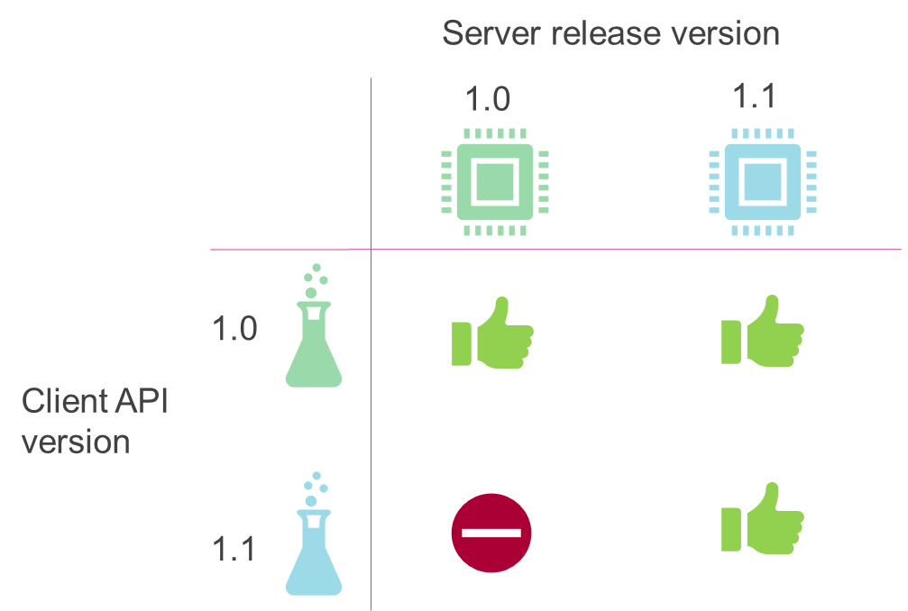
versioning.png
Server Release Version
1.0
1.1
1.0
Client API Version
1.1

Slide 5
apilifecycle.png
Draft
Beta
GA
Deprecated
Removed

